Slide 1
Checking understanding of addition and subtraction with fractions
Arithmetic procedures with fractions

Slide 2
how to use Oak lessons

Slide 3
I can use the mathematical structures that underpin the addition and subtraction of fractions.

Slide 4

Numerator − The expression in a fraction that is written above the fraction line. It is the dividend.
Denominator − The expression in a fraction that is written below the fraction line. It is the divisor.
numerator
denominator
A proper fraction is a fraction where the numerator is less than the denominator.
LCM is an abbreviation for lowest common multiple.

Slide 5

Checking understanding of addition and subtraction with fractions
Checking understanding of addition and subtraction
Further understanding of addition and subtraction

Slide 6
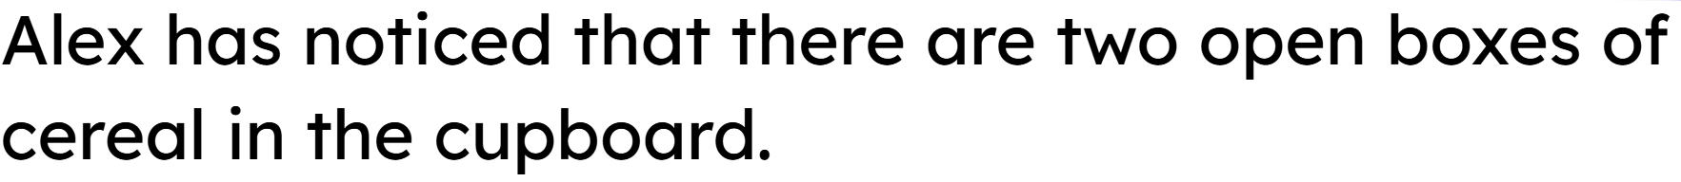


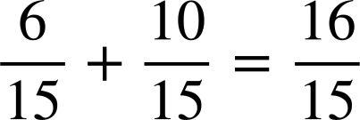
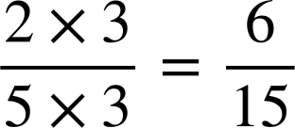
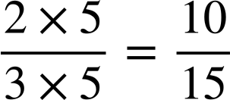
Checking understanding of addition and subtraction
=
Alex cannot fit both into the same box.
=

Slide 7
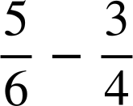

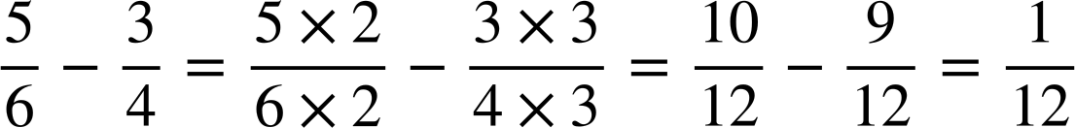

Checking understanding of addition and subtraction
To add or subtract fractions they must have the same denominator.
Aisha and Alex are working out the answer to this question.
Here are their workings:
Whose method do you prefer?
I prefer Alex’s as it is more efficient.
Alex
Aisha
Why is Alex’s method more efficient?
Alex has used the LCM of 6 and 4.

Slide 8
Checking understanding of addition and subtraction
The LCM of 6 and 4 is 12.
The LCM of 8 and 6 is 24.

Slide 9
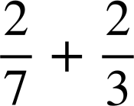
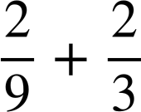
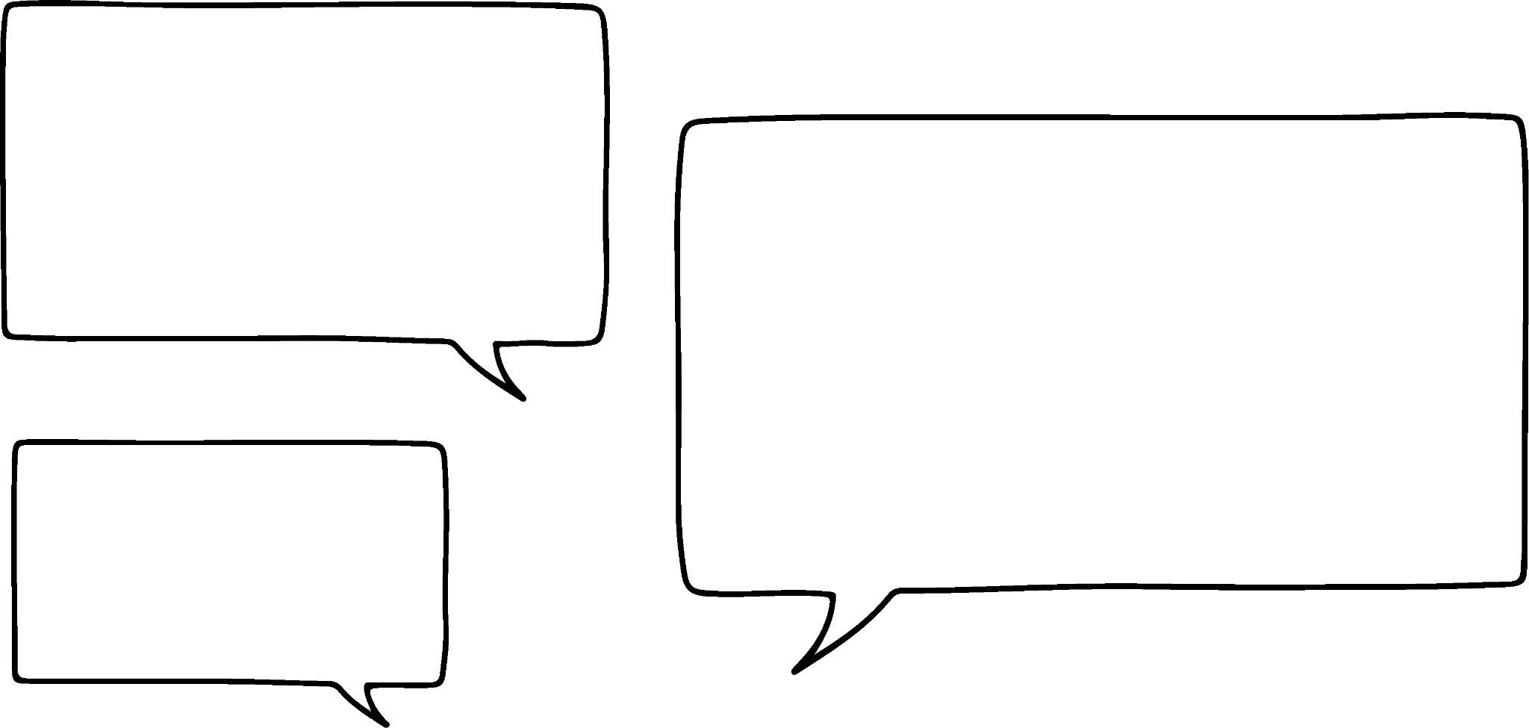


Checking understanding of addition and subtraction
Which is greater?
>
Is it necessary to calculate the exact answer?
Of course we will have to.
No we don’t.
Why might Aisha say that?
Alex
Aisha
is larger than and you are adding in both.

Slide 10

Checking understanding of addition and subtraction
What number is the arrow pointing at?
Here we have a negative answer.

Slide 11
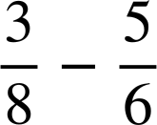
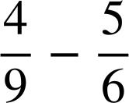
Checking understanding of addition and subtraction
What number is the arrow pointing at?
What number is the arrow pointing at?

Slide 12
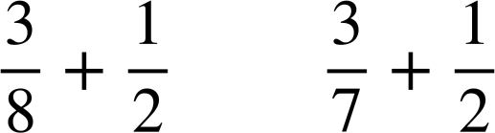
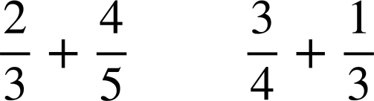
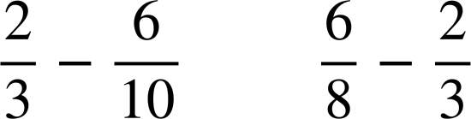
Checking understanding of addition and subtraction
1) Place the symbols < or > into the following. Try to only work out the exact answer if it is not obvious.
a)
b)
c)

Slide 13



Checking understanding of addition and subtraction
2) Find the missing value in each diagram. Give your answer in its simplest form.
?
?
a)
d)
?
?
b)
e)
?
?
c)
f)

Slide 14
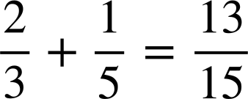
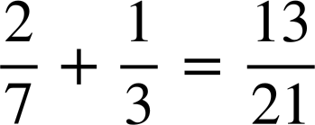
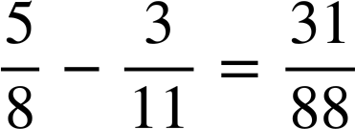
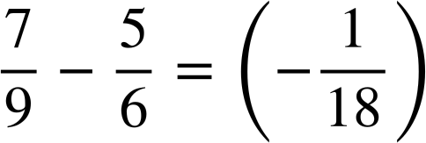
Checking understanding of addition and subtraction
3) Find the missing digits.
a)
c)
b)
d)

Slide 15
Checking understanding of addition and subtraction
1) Place the symbols < or > into the following. Try to only work out the exact answer if it is not obvious.
a)
b)
c)
<
>
<

Slide 16

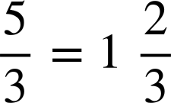
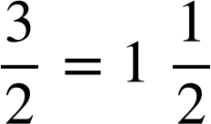

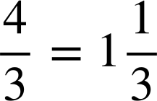
Checking understanding of addition and subtraction
2) Find the missing value in each diagram. Give your answer in its simplest form.
ANSWERS
?
?
a)
d)
?
?
b)
e)
?
?
c)
f)

Slide 17
Checking understanding of addition and subtraction
3) Find the missing digits.
a)
c)
b)
d)

Slide 18
Checking understanding of addition and subtraction with fractions
Checking understanding of addition and subtraction
Further understanding of addition and subtraction

Slide 19
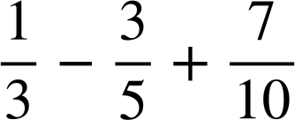
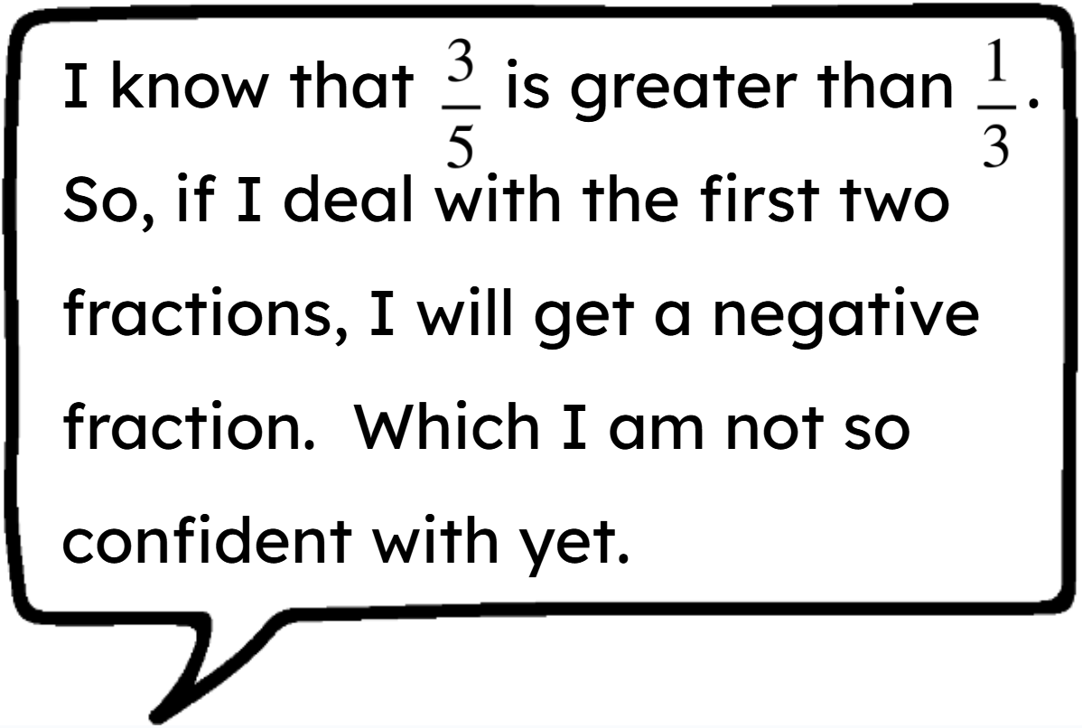
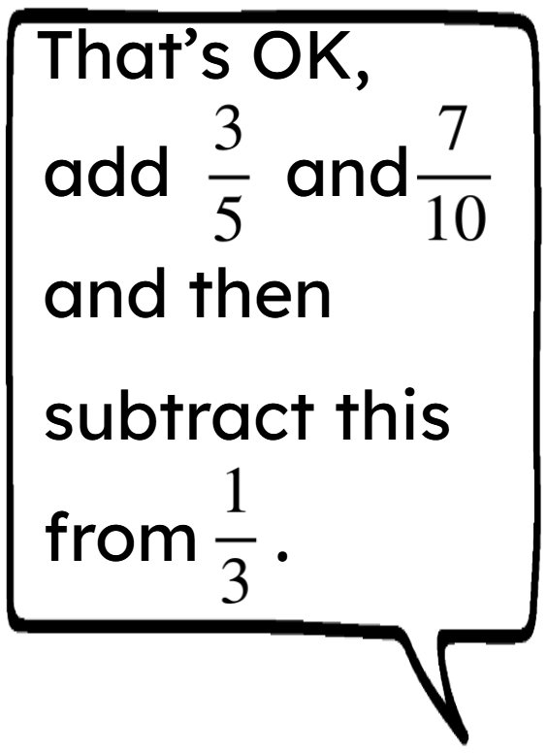
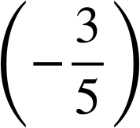
Further understanding of addition and subtraction
Aisha
Is Alex right?
Alex
No, we need to change the subtraction of to + and then we can change the order using commutativity of addition.

Slide 20
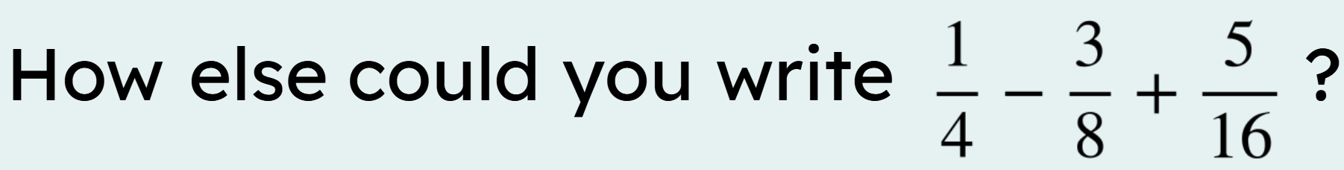
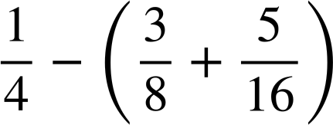
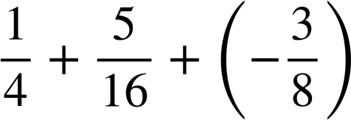

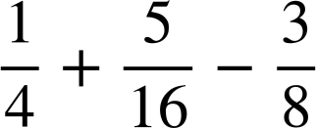
Further understanding of addition and subtraction
This is incorrect. The calculation is no longer subtracting and then adding
This is the same as b but adding the negative has been written as subtraction.

Slide 21
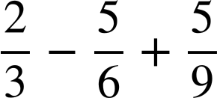
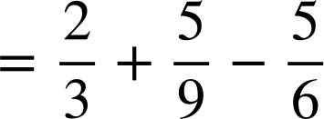
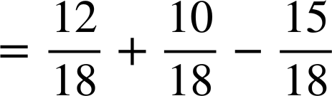
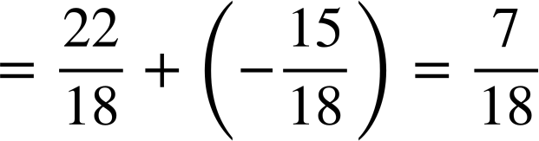
Further understanding of addition and subtraction
23 − 48 + 62
What would be the most efficient way to answer this question?
Reorder
to:
23 + 62
− 48
85
− 48
= 37
We can do the same with fractions.

Slide 22
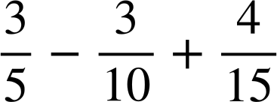

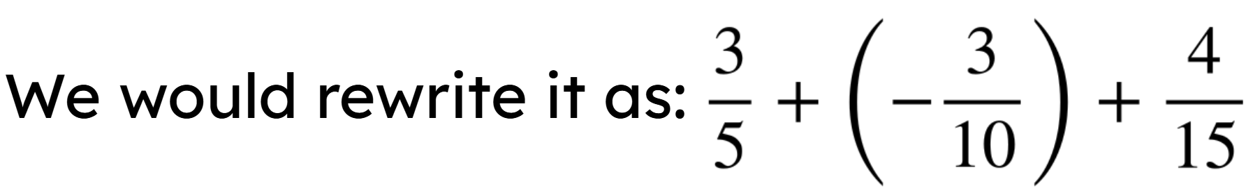
Further understanding of addition and subtraction
Would rearranging the calculation be useful here?

Slide 23
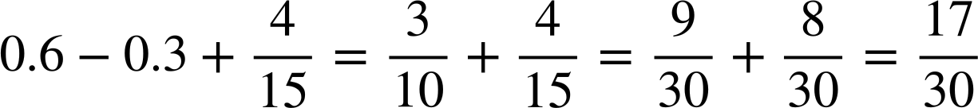
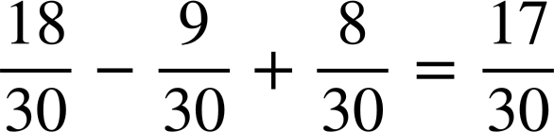
Further understanding of addition and subtraction
Aisha and Alex are working on this question.
Alex converts the fractions so that they have a common denominator.
Alex
Aisha

Slide 24
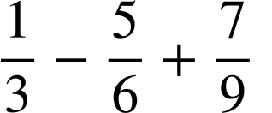
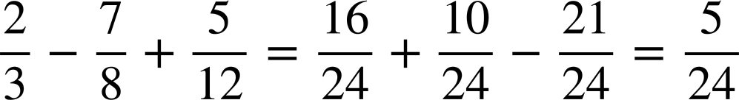
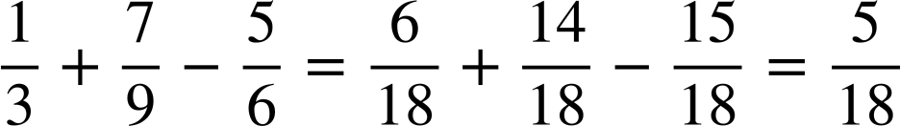
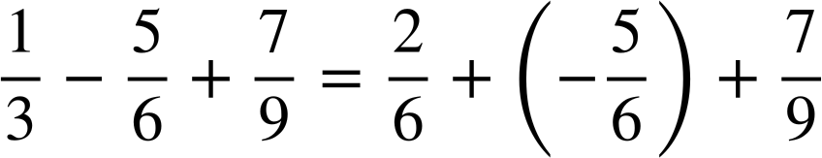
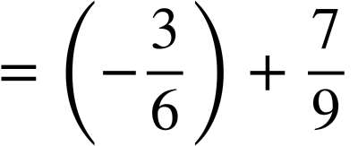
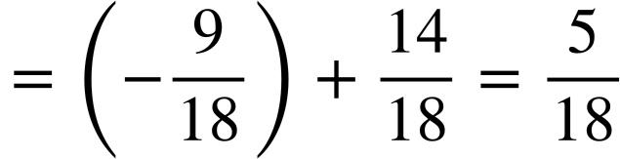
Further understanding of addition and subtraction
Calculate
Calculate
Even if you have different steps your final answer should be the same.

Slide 25
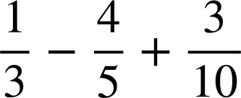
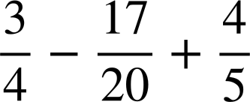
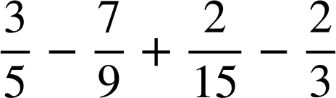
Further understanding of addition and subtraction
Calculate the answers to the following:
a)
b)
c)

Slide 26
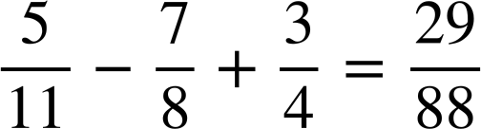
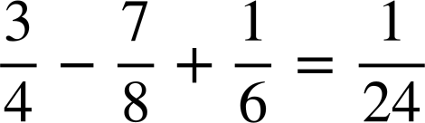

Further understanding of addition and subtraction
2) Find the missing digits in the following:
a)
b)
c)

Slide 27
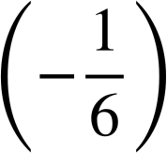

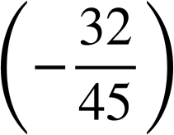
Further understanding of addition and subtraction
Calculate the answers to the following:
a)
b)
c)

Slide 28
Further understanding of addition and subtraction
2) Find the missing digits in the following:
a)
b)
c)

Slide 29


Checking understanding of addition and subtraction with fractions
It is not always necessary to calculate exact answers when adding and subtracting fractions if you are only comparing their size.
E.g.
When adding or subtracting fractions they must have a common denominator. The most efficient way is using the LCM.
E.g.
When adding and subtracting multiple fractions they can be reordered to make the calculation easier.
E.g.

Slide 30

© Oak National Academy 2023.
Produced in partnership with Mathematics in Education and Industry.
Licensed on the Open Government Licence v3.0, except where otherwise stated. See Oak terms and conditions.

